Slide 1
IB English Language and Literature
6 ELL SL 4
2019 - 2020
Shape of the Week (6):
Lesson 1: Exams Review plus COADF
Lesson 2: Exams Review plus COADF

Slide 2


SCHOOL ASSESSMENT TERM 3
☑ PRELIMS!!!

Slide 3
General Outline Term 3
WEEK 1 Paper 2 Prelim Prep
WEEK 2 Paper 1 Prelim Prep
WEEK 3 Prelims
WEEK 4 Prelims
WEEK 5 WT finalisation
WEEK 6 Chronicle
WEEK 7 Chronicle
WEEK 8 Chronicle
WEEK 9 Chronicle

Slide 4



We are still a digital classroom!

Slide 5


Slide 6
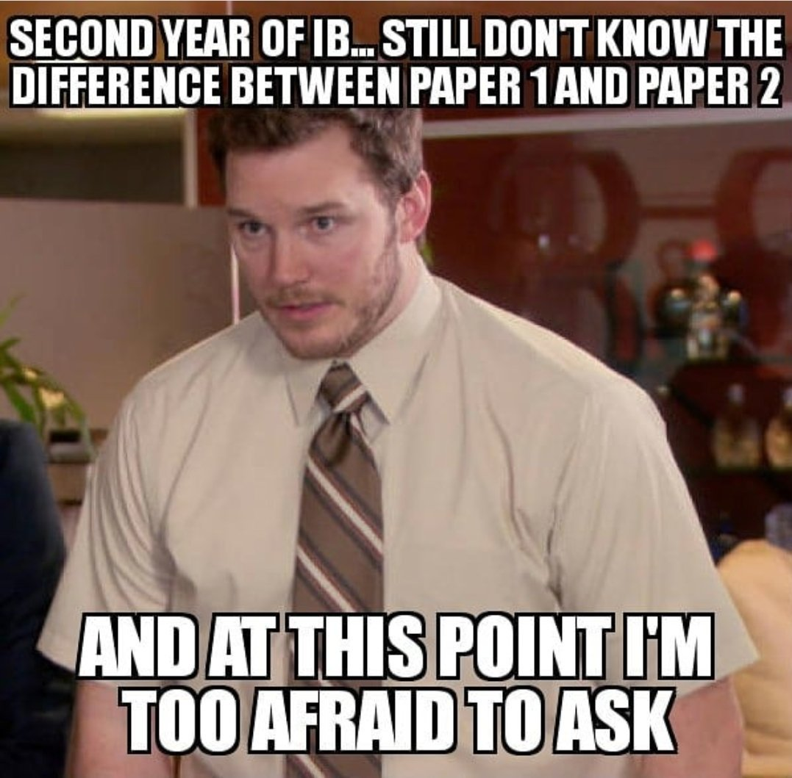
I KNOW SOME OF YOU IN THE CLASS ARE THINKING THIS…
Grade Boundaries P2 Last Year:
1 = 0-3
2 =4-7
3 = 8-11
4 = 12-14
5 = 15-17
6 = 18-20
7 = 21-25

Slide 7

Homework
Be prepared: Bring Chronicle
Continue to clean up Written Task.

Slide 8
COADF

Slide 9
Chronicle of a Death Foretold
Geographical, Biographical, Political and Literary Backdrop

Slide 10
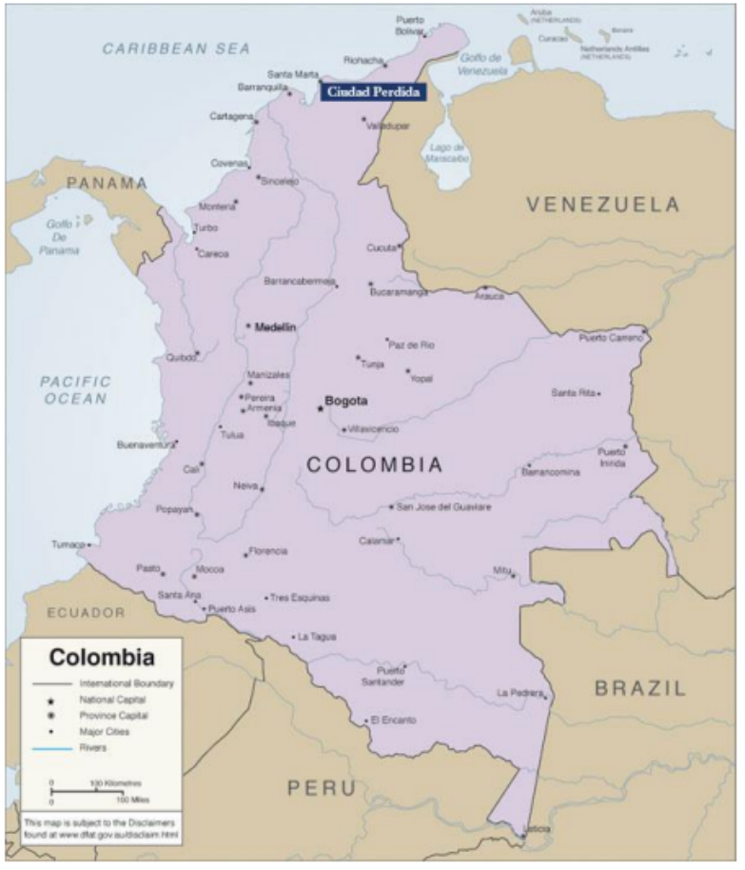
Colombia’s Geographical Split
Costeños
– Coastal Caribbean
– Racially mixed: descendents of pirates, black slaves, smugglers.
– Reputation: people are outgoing, superstitious, dancers, adventurous.
• Cachacos
– Central Highland
– Racially “pure”
– Formal, aristocratic, speak excellent Spanish, proud of advanced cities (Bogotá)
• Márquez
– Considers himself a mestizo costeño

Slide 11

Colombia’s Political Split
Background
– Two political parties emerged after independence from Spain in 1810.
– Neither possess firmly established ideologies and beliefs; are equally corrupt, abuse power, and are constantly at war with each other.
– It is said that Colombians don’t choose a party, they are born into one.
– Act as territorial and familial units.
• Liberals (Partido Liberal)
– Primarily Coastal Caribbean Costeños
• Conservatives (Partido Conservador)
– Primarily Central Highland Cachacos
• Márquez
– Liberal
– Parties form the political framework of much of his fiction.

Slide 12
DEVICES

Slide 13

Devices
Point of View: Role of the Narrator
Characterization: Behavior and dialogue
Narrative Structure: Non-chronological / differing perspectives = Search for truth
Journalistic Style: Sensational e.g. ‘Fatal door’ / 1st sentence- 5 Ws
Imagery: Rich, detailed and sometimes gruesome e.g. P119
Setting: Small Coastal Town – Historical Context

Slide 14
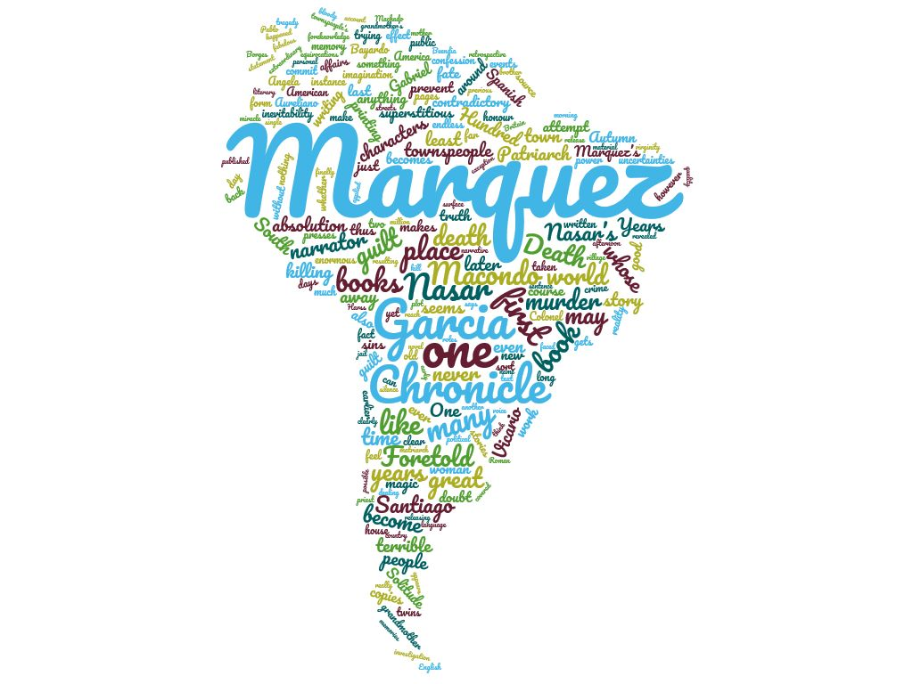
Devices
Symbolism:
The Smell of Santiago
Animals
Town officials a corrupt elite
Dreams: symbolic of supernatural belief
Prostitution - hypocrisy
Letters, documents - unreliable nature of communication
Falconry – predatory
Decrepit steamboat symbolic of Christianity

Slide 15
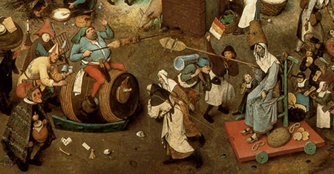
Devices
Irony: Used to criticize the village and its flaws.
Conflict: Character V Character / Character V Themselves / Character V Society
Foreshadowing: Santiago’s white clothes /‘He looked like a ghost’
Flashback & Flashforward: e.g Santiago’s early life / Bayardo’s courtship of Angela/ Consequences of the death
Biblical Allusions: Nasar as Christ/ Stabbed as Christ/ Roosters’ crowing when the Bishop denies the people and the people betray Santiago/ Nasar a reference to Jesus the Nazarene

Slide 16
QUIZ 1

Slide 17
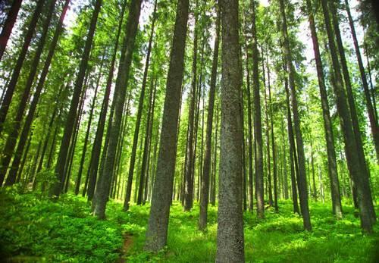
What two significant events are mentioned in the first sentence of the novel? How do you think they correlate?
Santiago Nasar woke up at 5:30 in the morning due to the bishop coming/ going to die that day.
realism / magical. Meeting member of religious (deals w/ supernatural) hierarchy/ Meeting supernatural realm.
How many years have passed since S Nasar’s death? Why do you think the narrator waits so many years to return to the village to investigate the murder?
27… explains (using TRUE STORY NOTES)

Slide 18

Briefly summarise Santiago’s dream the morning of his death. What does his mother believe dreams about birds indicate?
Dreams of being in a grove of timber trees in drizzling rain – then bird shit.
Birds – foretell health.
What is Santiago’s mother’s name? For what is she well known?
Placida Linero.
Interpreting dreams.

Slide 19
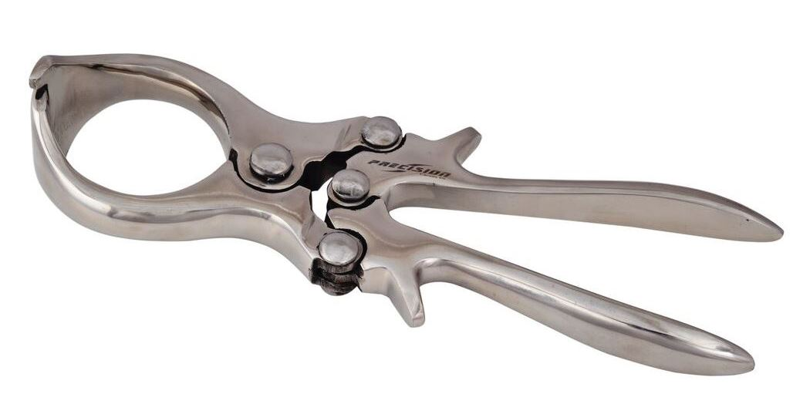
What is the Divine Face? What does Santiago do there? Symbolism?
Sanitago’s inherited ranch.
Castrates (gelds) calves.
Masculine Sexuality and this story!
Why does Santiago’s mother blame herself for his death?
Misinterpreted dream, shut the door on him.

Slide 20
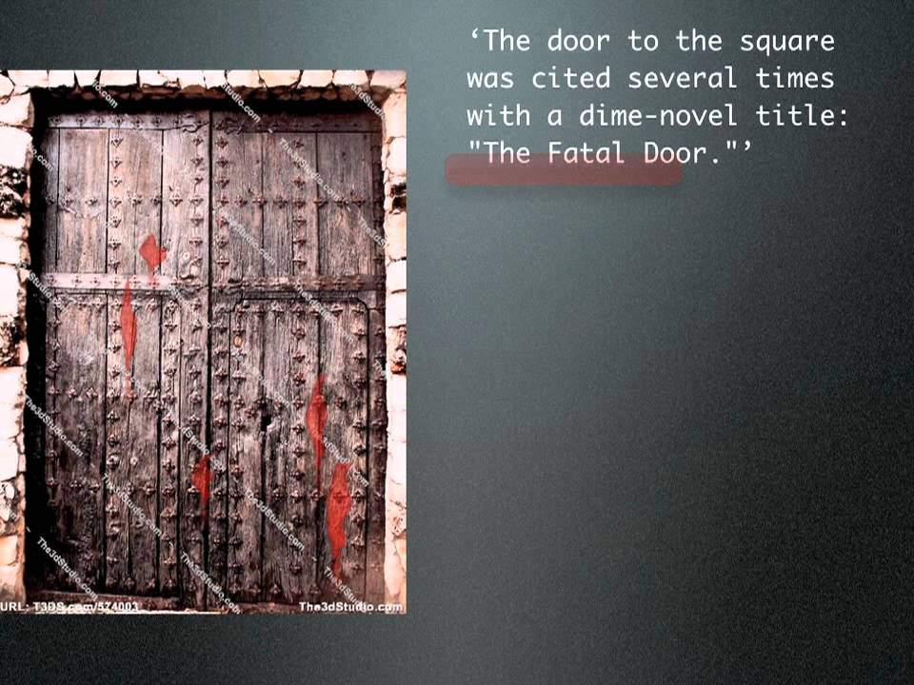
Who are Victoria Guzman and Divina Flor? How does Victoria feel about Santiago? What do you think his reaction to Divina indicates?
They are the maids of the Nasar home; mother and daughter. Victoria hates him, and his actions toward Divina indicate that she will be what Victoria was to his father.
What is the Fatal Door? Why is this door important to the plot?
It is the door he leaves the day of his death, but he usually never leaves through the door.

Slide 21
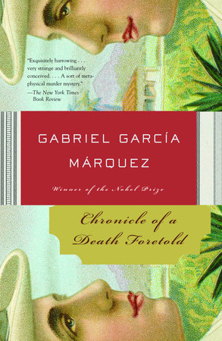
How do Victoria and Divina learn about the murder plot? Why don't they warn Santiago? What does Divina do in a futile attempt to help him? What do you think this indicates about her?
A beggar told them of the murder.
Victoria hates Santiago, Divina is too scared.
Divina leaves the doors unbarred.
She still cares for his life, despite his actions.
What does an unidentified person do in attempt to warn Santiago? Why does this fail?
They slipped a note under the door, but no one saw it.

Slide 22
Homework
Be prepared: Bring Chronicle
Read Context Documents on Managebac, Firefly.
Continue to clean up Written Task.

